Slide 1
Analytics Process

Slide 2
Business Problem
Objective of Analysis
Objectives of the analysis and data requirements are laid out in the proposal
Collect Inputs/ Clean inputs
Process Inputs
Interim Presentation
Exploratory Analysis
Build a relationship (Model)
Final Presentation
Use model results
Implement the model
Evaluate performance

Slide 3
Business Problem
- “what keeps you awake at night?”
- conduct interviews
- review of data
- important to get buy in
- data driven
- “see what can you do !!!”
- must connect with issues
- can lead to complex areas
Notes:
Even while data is starting point, it is important to connect with issues
This can lead to complex areas

Slide 4
Business Problem
- attack thump rules
- retail management/ CRM/ HR etc.
- student admission
- e-commerce in a big way
- conduct experiments
- evaluate the results
- freeze the best
- Standard/ repeated requirements
- models for response/ RoI estimation
- refresh models
- assess performance
Notes:
Student admission

Slide 5
Assess analytic readiness
- management readiness
- Data readiness
- IT readiness

Slide 6
Analytics Objectives
In general terms, it is
Process Improvement
Use historic process data to improve a process to save cost, improve efficiency, reduce time etc.

Slide 7
Analytics Objectives to Steps
The concept that will help is:-
Information Gaps
Increasing attrition of employees
>> identify factors leading to attrition (impact of experience, promotion, roles, department etc.)

Slide 8
A financial institution evaluated the cost of new customer acquisition and found that it is much higher than industry average.
Process improvement objective:- Reduce cost by better selecting prospective customers.
Information Gap:-
> who is the likely customer? (chance of response)
Analytics Objective:-
> estimate probability of response

Slide 9
A Financial institution is a regional player and started experiencing faster growth rate. The institution started expanding their team and found that going is getting tough due to shortage of talents esp loan approval.
Process Improvement:- Improve the loan approval process by automating as much as possible.
Information Gap:-
> Who is going to default the loan? (Chance of default)
Analytics Objective:-
> probability of default

Slide 10
A consumer marketing organization conducts large number of campaigns every year. It struggles to evaluate which campaign to repeat for one more year or which one to stop? Currently this decision is based on judgement.
Process Improvement:- Take decisions based on impact of campaigns.
Information Gap:-
> Impact of each of the campaigns
Analytics Objectives:-
> evaluate the impact of various campaigns in the last year

Slide 11
Which advertisement campaign to continue next year?
>> evaluate the impact of various campaigns in the last year
Reduce expenditure of contacting customers for promotion
>> shortlist customers with best chance of response >> estimate probability of response
High expenditure on manual approval of loans
>> automate decisions
>> estimate probability of default

Slide 12
Types of Analytics
Descriptive
Typically business intelligence. Explain the situation. Provide information at various levels of aggregation.
- report attrition by department/ seniority/ level
- report sales by sales territory or region
Predictive
Predict or forecast the behavior or result
- estimate the probability of attrition of employees
- estimate the sensitivity of sales to advertisement
Prescriptive
Suggest optimal course of action to achieve the objectives
- policy changes to reduce attrition (more training, better benefits based on analysis)
- optimal level of TV advertisement for maximizing sales

Slide 13
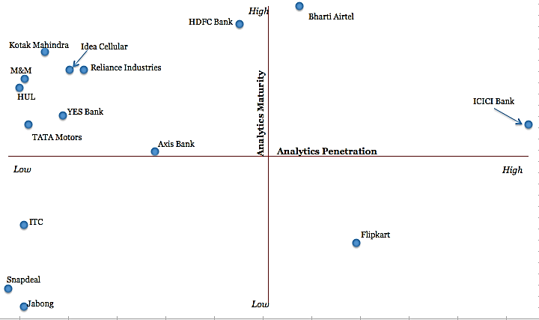
http://analyticsindiamag.com/a-study-on-domestic-indian-analytics-market/

Slide 14
Prediction vs Forecasting

Slide 15
Business Problem
Objective of Analysis
Collect Inputs/ Clean inputs
Collect Inputs
Process Inputs
Exploratory Analysis
Build a relationship (Model)
Implement the model
Evaluate performance

Slide 16
Collect Inputs
Based on conceptual model
Price
Weekly Avg Price
Sales
Promotion
Display/ Feature/ Discounts etc.
Media
TV, Newspaper, Radio, Hoarding etc
Some of the variables may not be available/ May be available but at different levels (weekly, monthly, state, country)/ accuracy also may vary

Slide 17
Conceptual model
Salary, promotion, flexibility
Benefits
Age, Gender, Experience etc.
Personal
Attrition
Team
Lead style, Structure etc.
Environment
Skill demand, Industry growth etc
Some of the variables may not be available/ May be available but at different levels (weekly, monthly, state, country)/ accuracy also may vary

Slide 18
Business Problem
Objective of Analysis
Collect Inputs/ Clean inputs
Clean Inputs
Process Inputs
Exploratory Analysis
Build a relationship (Model)
Implement the model
Evaluate performance

Slide 19
Missing Value Treatment

Slide 20
Missing values
Missing Data occurs in a data set when a value is missing.
- it could be marked . in case of missing numerical values
- NA, #N/A, ‘ ‘, etc., in the case of character values.
- watch out for FLAGS like 99, 999 etc.

Slide 21
In cases where numerical missing values are legitimate, it can be replaced with zeroes.
- In a customer profile dataset, Is the following missing values legitimate? Will you replace with zero?
- Income
- Age
- Loan outstanding
- Debt Ratio
- performance appraisal rating of an employee

Slide 22
Missing value Treatment
List wise deletion
If a missing value occurs on any of the variables, eliminate the entire observation.
Consequence:- A data set with even a modest amount of missing values scattered throughout can result in a substantial reduction in sample size.
- default in all statistical packages

Slide 23
Imputation
Imputation describes the process of filling in the missing values of a variable.
1. Substitution with a measure of central tendency
Mean (for continuous values)
Median (for ordinal values)
Mode (for nominal columns)
2. Distribution based
• Replacement values are calculated based on the random percentiles of the variable’s distribution.
• Values are assigned based on the probability distribution of the non-missing observations.
• This imputation method seeks to preserve the empirical distribution of the data.

Slide 24
3. Tree Imputation
• Replacement values are estimated by treating this input as a target, and using the remaining input variables (and other rejected variables) as predictors in a Decision Tree.
• The predicted value obtained from the Decision Tree replaces the missing value.
Because the imputed value is based on other input variables, this techniques may be more accurate than simply substituting a measure of central tendency.

Slide 25
4. Regression Imputation
• Replacement values are estimated by treating this input as a target, and using the remaining input variables (and other rejected variables) as predictors in a Regression Model
• The predicted value obtained from the Regression replaces the missing value.
Because the imputed value is based on other input variables, this techniques may be more accurate than simply substituting with mean.

Slide 26
5. Multiple Imputation
1. Sets of plausible values for missing observations are created that reflect uncertainty about the non-responses. Each of these sets of plausible values is used to replace the missing values and create a completed data set.
2. Each of these completed data sets is analyzed.
3. The results of these analyses are then combined, which allows the uncertainty regarding the imputation to be taken into account.
Availability of Imputation Algorithms
• SAS Enterprise Miner
– Substitution with a measure of central tendency
– Distribution based
– Tree Imputation
• SAS Procedures MI & MIAnalyze
– Multiple Imputation

Slide 27
# drop missing rows if any column got missing values
data_name.dropna()
# replace missing values with 0 for a column
data_name[‘column_name’].replace(0, np.nan, inplace= True)
# replace NaN values with the mean
train['Age']=train['Age'].fillna(train['Age'].mean())
# for Median
train['Age']=train['Age'].fillna(train['Age'].median())
# for back-fill
train.fillna(method='bfill’)
# for forward-fill
train.fillna(method=''ffill)

Slide 28
# categorical column
df = df.fillna(df.mode().iloc[0])
# using Imputer
from sklearn.impute import SimpleImputer
my_imputer = SimpleImputer()
data_imputed_values =my_imputer.fit_transform(original_data)

Slide 29
Business Problem
Objective of Analysis
Collect Inputs/ Clean inputs
Outlier Detection and Treatment
Process Inputs
Exploratory Analysis
Build a relationship (Model)
Implement the model
Evaluate performance

Slide 30
Definition by Hawkins
“An outlier is an observation which deviates so much from the other observations as to arouse suspicions that it was generated by a different mechanism” [Hawkins 1980]:
Hence, outliers are cases that have data values that are very different from the data values for the majority of cases in the data set.
Outliers are important because they can change the results of data analysis.
Whether we include or exclude outliers from a data analysis depends on the reason why the case is an outlier and the purpose of the analysis.

Slide 31
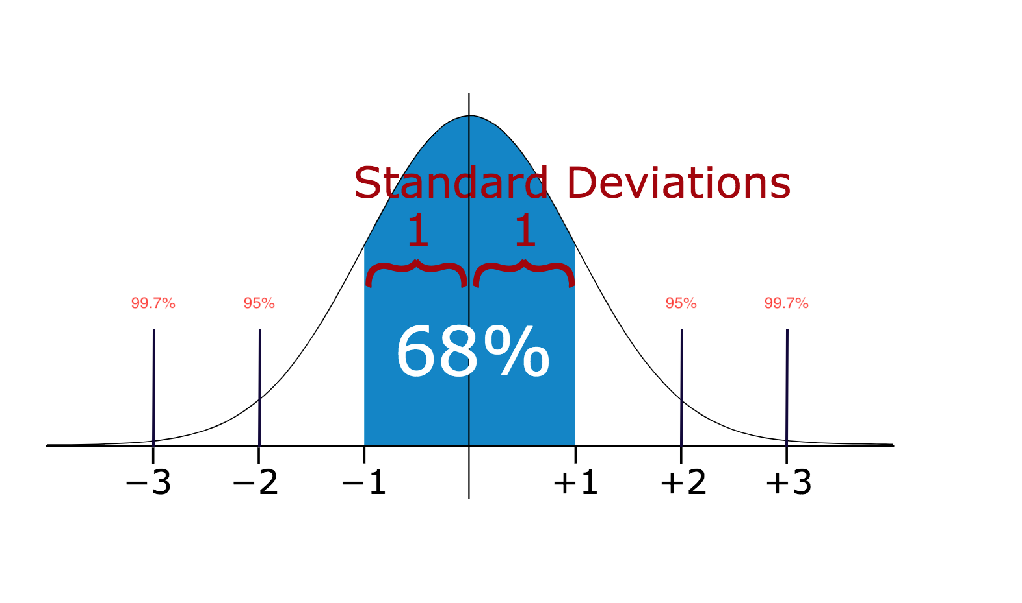
Identification
Standard Deviation
Method 1 — Standard Deviation
If a data distribution is approximately normal then about 68% of the data values lie within one standard deviation of the mean and about 95% are within two standard deviations, and about 99.7% lie within three standard deviations

Slide 32
One way to identify outliers is to convert all variables to standard scores.
If the sample size is small (80 or fewer cases), a case is an outlier if its standard score is ±2.5 or beyond.
If the sample size is larger than 80 cases, a case is an outlier if its standard score is ±3.0 or beyond
Average repayment period is 40 weeks. Hence, 60 week is an outlier as in the chart.
Outlier

Slide 33
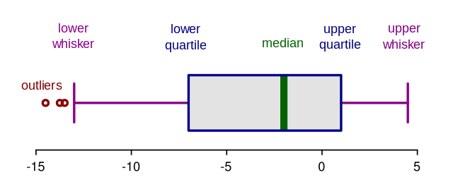
Method 2 — Boxplots
Box plots are a graphical depiction of numerical data through their quantiles. It is a very simple but effective way to visualize outliers.

Slide 34
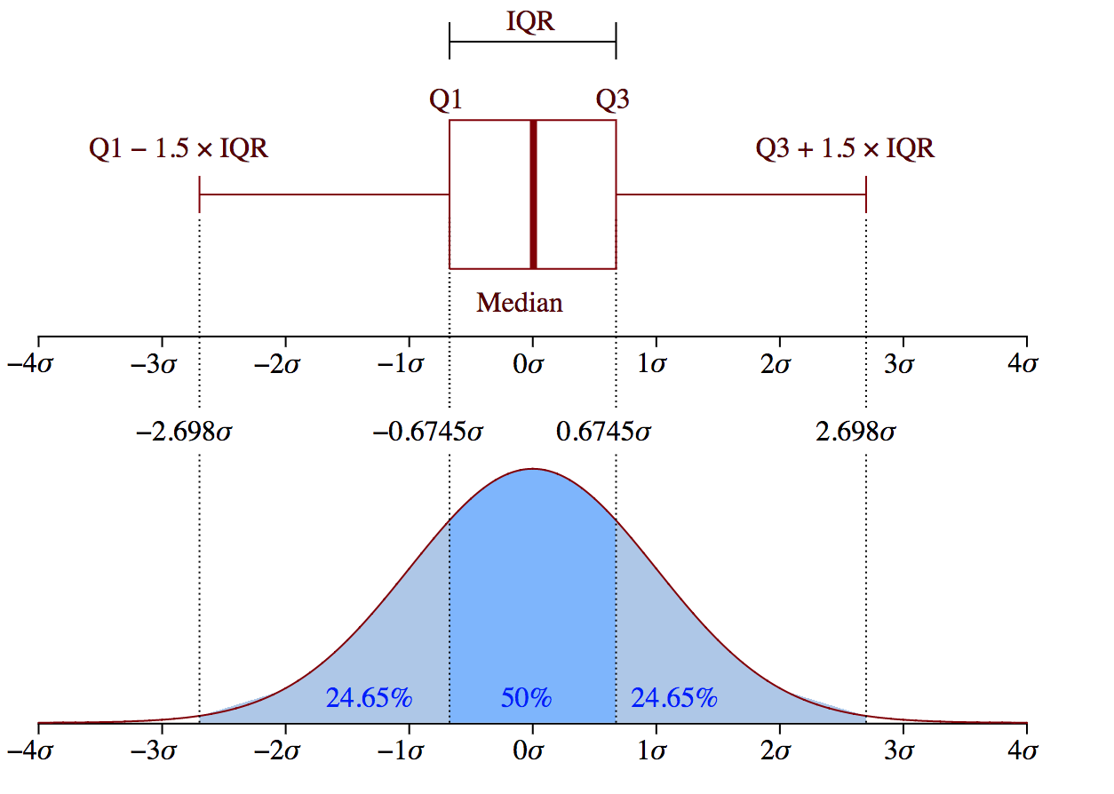

Slide 35
Treatment
Usually outliers are not usually deleted. It is capped to the maximum possible value. Hence, in the previous example, the maximum value (60) is corrected to 46.

Slide 36
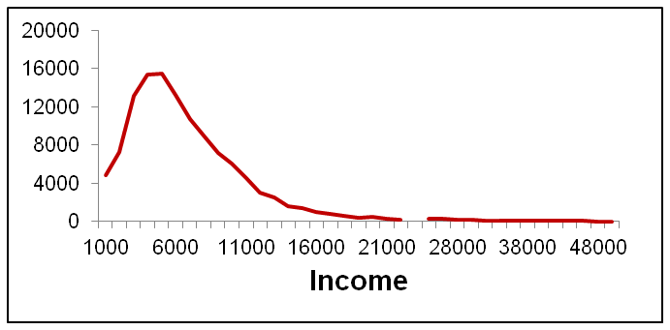
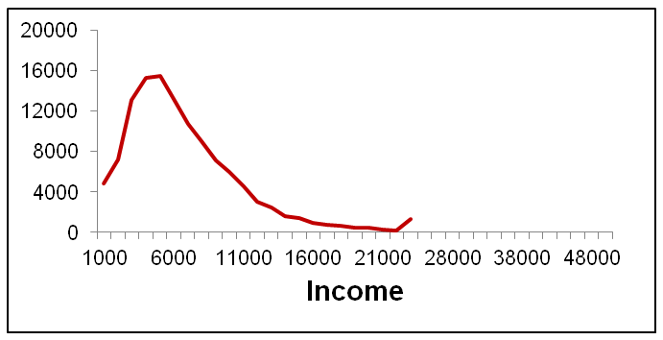
The figures show the distribution of income before and after removing outliers.
This code will restrict the income between 1000 and 24000

Slide 37
def Remove_Outlier_Indices(df):
Q1 = df.quantile(0.25)
Q3 = df.quantile(0.75)
IQR = Q3 - Q1
trueList = ~((df < (Q1 - 1.5 * IQR)) |(df > (Q3 + 1.5 * IQR)))
return trueList
# Arbitrary Dataset for the Example
df = pd.DataFrame({'Data':np.random.normal(size=200)})
# Index List of Non-Outliers
nonOutlierList = Remove_Outlier_Indices(df)
# Non-Outlier Subset of the Given Dataset
dfSubset = df[nonOutlierList]

Slide 38
df=pd.DataFrame({'Data':np.random.normal(size=200)})
#example df[np.abs(df.Data-df.Data.mean())<=(3*df.Data.std())]
#keep only the ones that are within +3 to -3 standard deviations in the column 'Data’.
df[~(np.abs(df.Data-df.Data.mean())>(3*df.Data.std()))]

Slide 39
Outliers in the dependent variable might require a different design.

Slide 40
Business Problem
Objective of Analysis
Collect Inputs/ Clean inputs
Processing Inputs
Processing Inputs
Exploratory Analysis
Build a relationship (Model)
Implement the model
Evaluate performance

Slide 41
Process Inputs
Reduce Granularity
Data can come at weekly or monthly level for few years. Or it could be at smaller geographical level. Such detail is not always useful.
- aggregate at 3 monthly or 6 monthly level.
- aggregation can be overlaying too. Last 3/6/9/12 months
Derive new variables
Some variables are combined or ratio calculated to increase the explanatory value.
- amount outstanding (rather than payment)
- ratio of value added service to total (rather than actual amount)
- many financial ratios

Slide 42
Match consumer behavior
Consumers remember advertisements and that influence their response. Hence, the impact last over a period of time with diminishing influence. Hence, such variable needs to be treated to match this behaviour.

Slide 43
Business Problem
Objective of Analysis
Collect Inputs/ Clean inputs
Exploratory Analysis
Process Inputs
Exploratory Analysis
Build a relationship (Model)
Implement the model
Evaluate performance

Slide 44
Scales of Measurement

Slide 45
Scales of Measurement
Scales of measurement limit the types of analysis that can be performed.
Common Scales of measurement are
Nominal
Ordinal
Interval
Ratio
Notes:
4

Slide 46
Nominal
In this scale, usage of number is only as a flag as it doesn’t use the value of a number at all.
It is used for classification or categorization of entities.
- Gender (1=Female, 2=Male)
- Region (1=North, 2=South, 3=East, 4=West)

Slide 47
Ordinal
Here, the usage of number is to rank order entities which helps us to decide which one is higher, smaller, taller etc. Some of the examples are below.
- Rating of service provided by clients like
1=high, 2=medium, 3=low.
Here we know rating of low is the lowest compared to other two.
Rating | Income Range
1 | < 5000
2 | 5001 – 15000
3 | 15001 – 30000
4 | >30000

Slide 48
Likert Scale
Another common usage of ordinal scale is for attitudinal measurements. Usual responses like strongly agree, agree etc. are given a numerical scale that helps rank order the responses.
Rating | Agreement to Policy Change
1 | Strongly Agree
2 | Agree
3 | Neutral/ No Opinion
4 | Disagree
5 | Strongly Disagree

Slide 49
Interval
In the interval scale, equal numerical difference represents equal quantities. Unlike in the case of ordinal scale, the unit is well defined and standardized so that it doesn’t vary by time, place or researcher.
- All measurement of time are in interval scale
- Temperature measurement. The origin is arbitrary (freezing point of water if measured in ºC) and what matters is the difference.

Slide 50
Ratio
Ratio scale is the highest level of usage of a number. In ratio scale, the interval (difference) is meaningful as well as the quantity (origin is meaningful). Since the quantity is meaningful, the ratio is meaningful and hence the name.
- Physical measures like length, weight, age etc. as well as commercial measures like revenue, income, turnover etc.

Slide 51
Exploratory Data Analysis

Slide 52
Exploratory Data Analysis
The objective of EDA is to
Maximize insight into a dataset
Uncover underlying structure
Extract important variables
Detect anomalies
Test underlying assumptions
Most EDA techniques are graphical in nature with a few quantitative techniques. Broadly this can be grouped into univariate and bivariate analysis.

Slide 53
Univariate Analysis
Univariate analysis considers only one variable at a time. The usual techniques are Distribution, Central Tendency & Dispersion.
Distribution is a summary of frequency of individual values or ranges of values. An important aspect of distribution is the shape of the distribution. A researcher is interested in how well the distribution is approximated by normal distribution.

Slide 54
Central Tendency
Central tendency of a distribution is an estimate of centre of a distribution of values. There are 3 major types of measures.
Mean/ Median / Mode
Dispersion
Averages are representatives of a distribution but they fail to give a complete picture of the distribution. They do not tell anything about the scatter.
Consider results of two types of weighing m/cs. Mean weight of packets are same. But the performance are not same. Range, Standard Deviation, Coefficient of Variation are the usual measures of dispersion.
Variety | Mean | Range | SD | CV
Type I | 42 | 5 | 1.87 | 0.04
Type II | 42 | 24 | 10.04 | 0.24

Slide 55
Bivariate Analysis
Bivariate analysis helps us to:-
Look at associations/relationships of among two variables.
Look at measures of the strength of the relationship between two variables.
Test hypotheses about relationships
In a typical analytic project, the focus will be on bivariate analysis between dependent variable and each of the independent variables.
For example, what does this table tell us about opinions on welfare by gender?
Provide liberal subsidies for poor | Male | Female
Yes | 150 (60%) | 200 (20%)
No | 100 (40%) | 800 (80%)
Total | 250 (100%) | 1000 (100%)

Slide 56
Provide liberal subsidies for poor | Male | Female | Total
Yes | 150 (43%) | 200 (57%) | 350 (100%)
No | 100 (11%) | 800 (89%) | 900 (100%)

Slide 57
Avoid plotting raw numbers – always choose mean or proportions

Slide 58
Avoid plotting raw numbers – always choose mean or proportions

Slide 59
Visualization
Variable1 | Variable2
Categorical (Default (yes/no) | Categorical (Educational Degree)
What chart will you adopt?

Slide 60
Chi-square test was conducted and the independence of Default and Education was rejected (α = 0.05) (Default and Education are dependent).

Slide 61
Visualization
Variable1 | Variable2
Continuous (Salary) | Categorical (Department – Mktg, Fin etc.)
What chart will you adopt?

Slide 62




Analysis of Variance
ANOVA test was conducted and the salary differs significantly between departments (α = 0.01)

Slide 63
Visualization
Variable1 | Variable2
Continuous (Age) | Continuous (Income)
What chart will you adopt?

Slide 64
Analysis of Variance
ANOVA test was conducted and the Income differs significantly between Age classes (α = 0.01)

Slide 65
Thank You

Slide 66
Hypothesis Tests

Slide 67
Hypothesis Tests
Variable1 | Variable2 | Test | Example of Hypothesis
Continuous (Interval/ Ratio) | Categorical (Two categories) | T-test | H₀: µ1 = µ2 H₁: µ1 ≠ µ2
Categorical (two categories) | Categorical (Two categories) | T-test | H₀: p1 = p2 H₁: p1 ≠ p2
Continuous (Interval/ Ratio) | Categorical (more than two categories) | ANOVA | H₀: µ1 = µ2= µ3= µ4…. H₁: µ1 ≠ µ2≠ µ3 ≠ µ4….
Categorical | Categorical (more than two categories) | Chi-Square Test | H₀: X and Y are independent H₁: X and Y are dependent

Slide 68
Chi-square test was conducted and the independence of Default and Education was rejected (α = 0.05) (Default and Education are dependent).

Slide 69
Analysis of Variance
ANOVA test was conducted and the salary differs significantly between departments (α = 0.01)

Slide 70
Correlation Analysis
Correlation analysis is usually conducted between pairs of independent variables. This will provide warning towards possible multi-collinearity issues.
Correlation between 4 TV campaigns
Table shows that TVCamp1 is highly correlated with TVCamp2 and TVCamp3. Hence, it will not be possible to model these variables separately.
 | TV Camp1 | TV Camp2 | TV Camp3 | TV Camp4
TV Camp1 | 1
TV Camp2 | 0.80 | 1
TV Camp3 | 0.70 | 0.35 | 1
TV Camp4 | 0.35 | 0.20 | 0.4 | 1

Slide 71
Distribution
To plot distribution, we consider dependent variable (eg.default) and one of the independent variables (eg. income).
The income is grouped such that approx. equal proportion falls in each class. Proportion of default is calculated.
The nature of distribution provide clues to the importance of variables in influencing dependent variable. This also will provide pointers to the transformation of variables. For example, the above chart suggest that income may be grouped into a binary variable (income<=4040/ income>4040).

Slide 72
Custard | Jatropha | Honge
16 | 20 | 9
17 | 21 | 8
15 | 19 | 7
17 | 21 | 9
16 | 19 | 8
17 |  | 7
16 | 20 | 8
ANOVA
TEST1
Sum of Squares df Mean Square F Sig.
Between Groups 424.902 2 212.451 262.439 .000
Within Groups 11.333 14 .810
Total 436.235 16

Slide 73
Custard | Jatropha | Honge
26 | 30 | 4
7 | 21 | 13
15 | 9 | 7
7 | 31 | 4
26 | 9 | 8
17 |  | 12
16 | 20 | 8
ANOVA
TEST2
Sum of Squares df Mean Square F Sig.
Between Groups 424.902 2 212.451 3.300 .067
Within Groups 901.333 14 64.381
Total 1326.235 16

Slide 74
Techniques being applied are cross tabulation, correlation analysis etc.
Cross Tabulation
Consider the table below.
Income | Education
 | High | Low | Total
High (> $40,000) | 40 | 10 | 50
Low (<=$39,999 ) | 10 | 40 | 50
Total | 50 | 50 | 100
Calculated Chi-Square value is 36. At a significance level of 0.01, chi-square value is 6.64. Do we accept or reject the null hypothesis?

